Slide 1
ITM 891 Project Lending Club loan risk prediction
Prudhvi B

Slide 2
Data source
Source: Lending Club a peer to peer lending platform https://www.kaggle.com/wendykan/lending-club-loan-data/kernels
Financial loan data 2007-2015
Loan Data:
Loan status,amount etc
Borrower data: Employment,credit scores

Slide 3
Enquiry Phase
What types of problems can be solved using this data?
Predict outcomes of loans : default or no default
Predict the length of the loan repayment
Predict the amount of loan being repayed
Predict on a subset of loans
Predict outcomes of entire dataset
Notes:
Some of the questions we are trying to answer
How many unique entries we have?
What are the various counts of Loan Statuses?
What's the distribution of Amount of loans?
What's the distribution of Interest Rate?
How is the investor fund distribution?

Slide 4
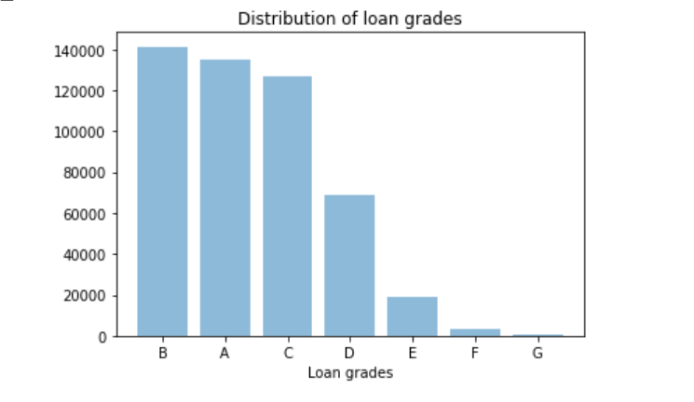
Enquiry Phase
What is the business problem?
There are 2 major aspects influencing a loan disbursement
1)Risk –> interest rate,loan grades
2)Repayment probability->Loan status
Types of loans grades
Where does the profit lie ?
Loan
Risk
Loan status
Predicting bad loans among high interest rate loans

Slide 5
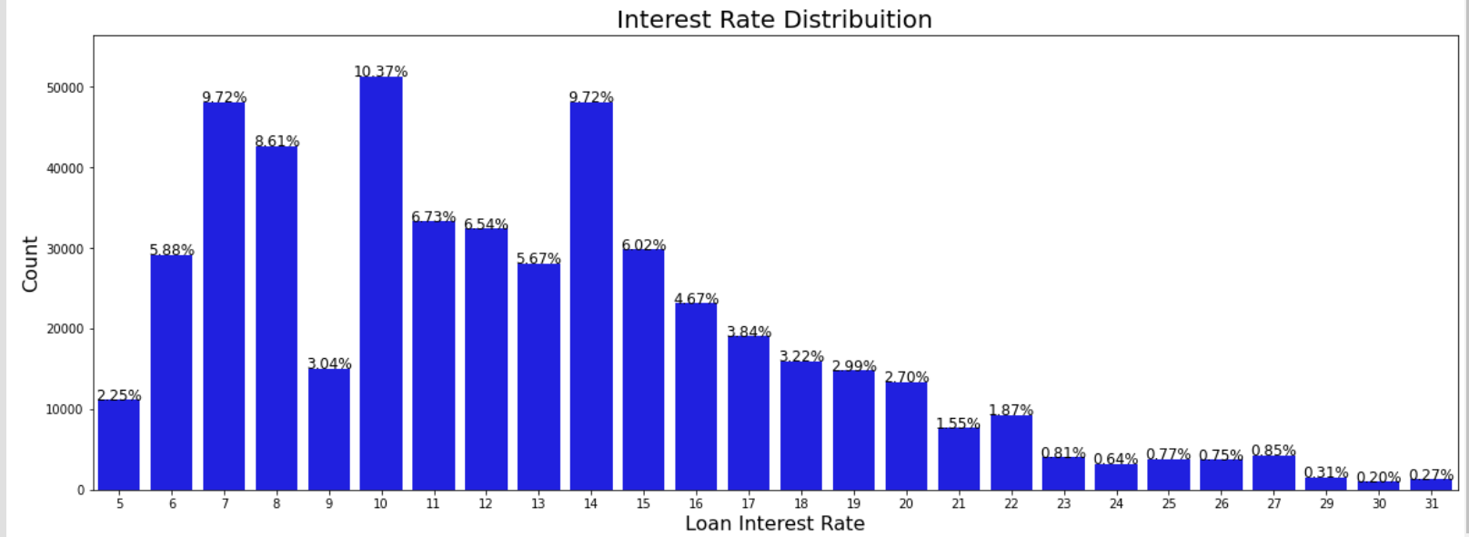
EDA

Slide 6
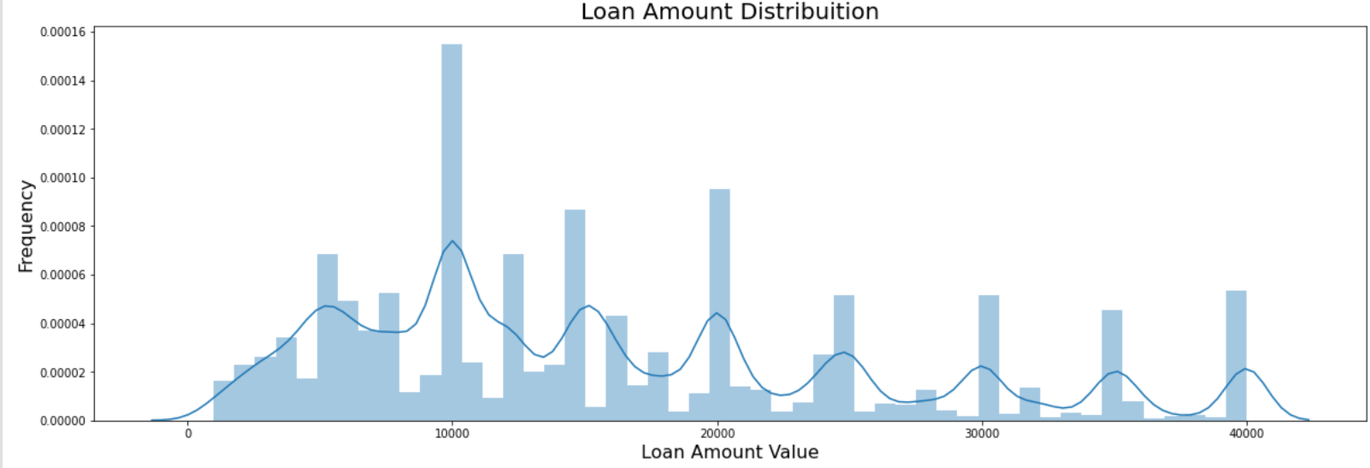
EDA

Slide 7
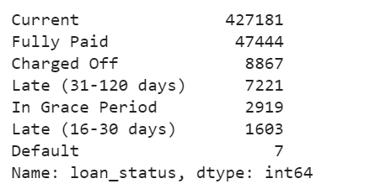
Defining Target feature
Define good loans,bad loans in data
Identify the classification metric
Count of loan statuses
Note:The dataset is highly imbalanced so need to take care of that,Ratio =0.037
Loan status is an ideal metric
Good loans: Current,Fully Paid,Grace period as good loans
Bad loans: Default,Late(16-30)&(31-120),Charged off
Assigning 0s and 1s to bad and good loans

Slide 8
Data Processing
Initial size & dim
filter to reduce size
2018-19 loans
151 columns,
2 mil rows
151 columns,
500k rows
Removing irrelevant columns
Check for missing values and fill accordingly
EDA of some variables
Check assignment of dtypes
multicollinearity in numeric,categorical
variables
Notes:
Irrelevant columns : the loan data here consists of the loans which have been given so it consists of loan

Slide 9
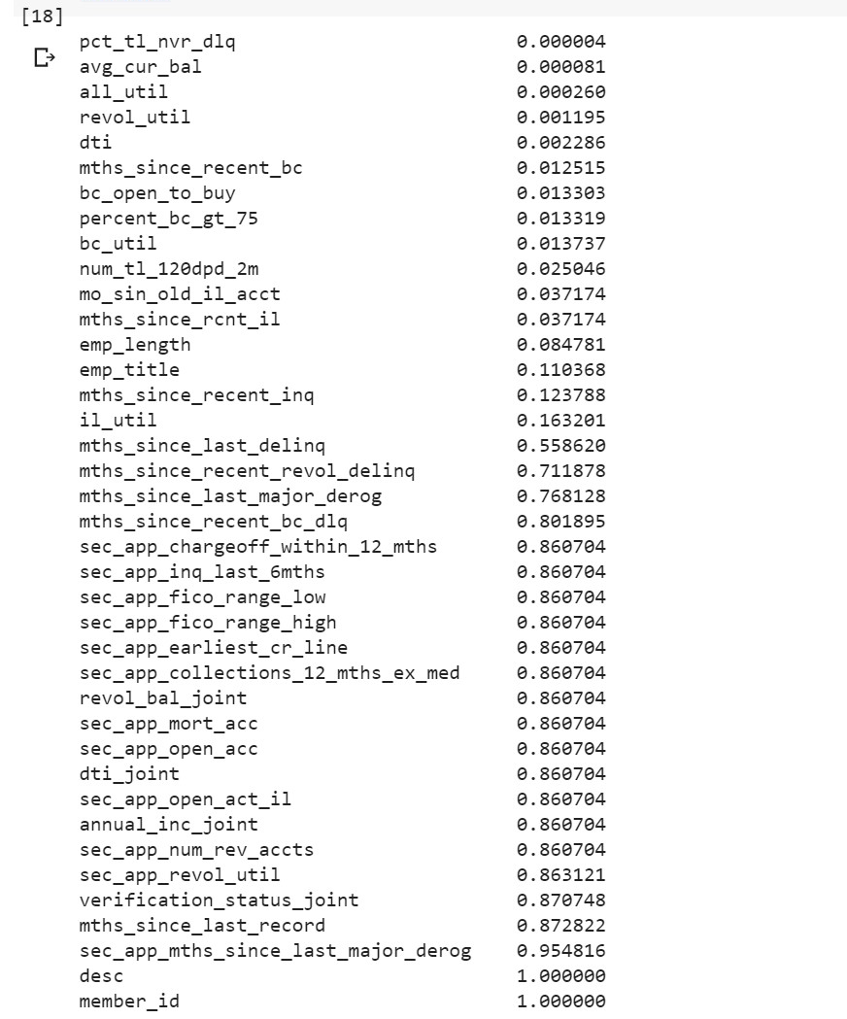
Missing Values treatment
Missing values ratios were calculated for every column
fill w empty
strings
Removing columns with ratio =1
Categorical
Filling NAs
Numerical
Filling min values
Filling max values

Slide 10
Modelling approach
Used for datasets with lot of unique
values in categorical variables
Filtering high risk grade E loans
Splitting into training, validation and test
Types of models :Decision trees
CatBoost package for decision trees

Slide 11
Model description and parameters
Parameters
1)Learning rate: It is calculated automatically for given number of iterations but here we have set it to 0.03
2)Early stopping rounds:set to 100 (0.1 of the parameter iterations) to stop the training and to save time if overfitting is observed
3)Class weights :Since the dataset is highly imbalanced, the ratio of two classes n[0] / n[1] is passed to the parameter class_weights. Using class weights here is equivalent to random oversampling.
CaBoost:gradient library based on decision trees
Uses mean encoding instead of one hot encoding

Slide 12
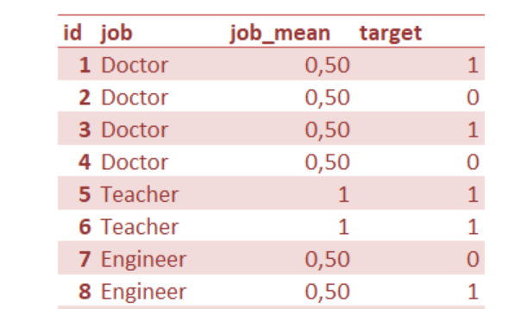
Continuation…..
Mean encoding ex:Mean encoding is ratio of occurrence of the positive class in the target variable.
Before fitting the model it is transformed into Catboost object Pool()
The model is defined using the object CatBoostClassifier() with
several parameters.
Final process
Fitting the model on training data
Predicting test data targets
Calculating accuracy metrics

Slide 13
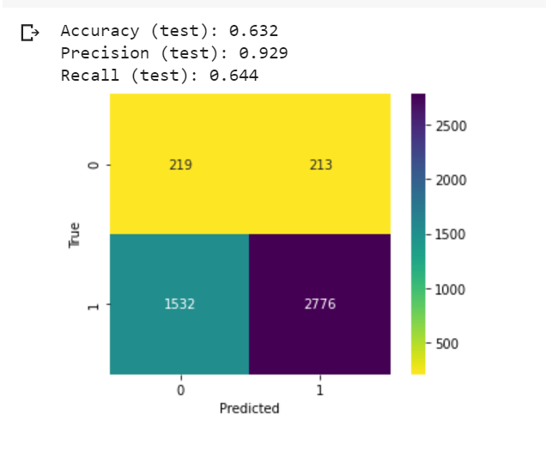
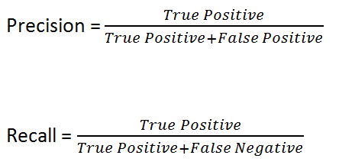
Accuracy metrics
Currently Optimizing both precision and recall.

Slide 14
Results and interpretation
Present scenario
Note : In current scenario reducing false positives is high priority since we don’t want to predict a bad loan as good which is a worse consequence than reducing false negatives. So our focus should be on increasing Precision at the cost of reducing Recall.
Optimizing both precision and recall
Increasing Precision by reducing False positive occurences
Reducing recall by minimizing it will lead to more False negatives

Slide 15
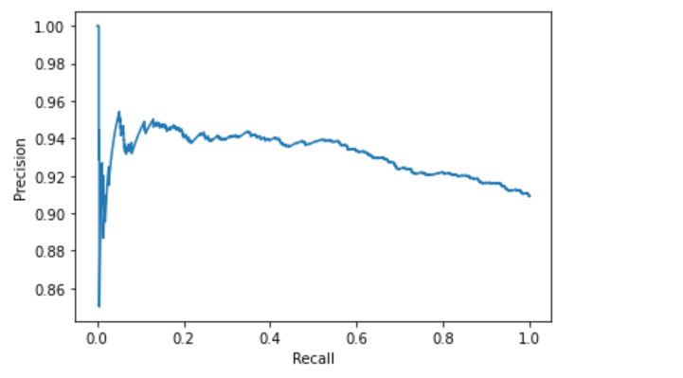
Recall vs Precision graph
We can set the threshold by calculating the curve on
validation data.
We select the second highest precision after 1 since it
has very low recall against it.

Slide 16
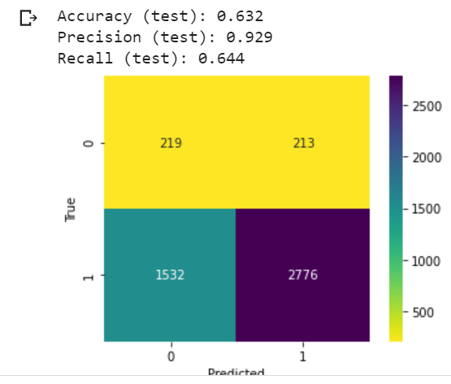
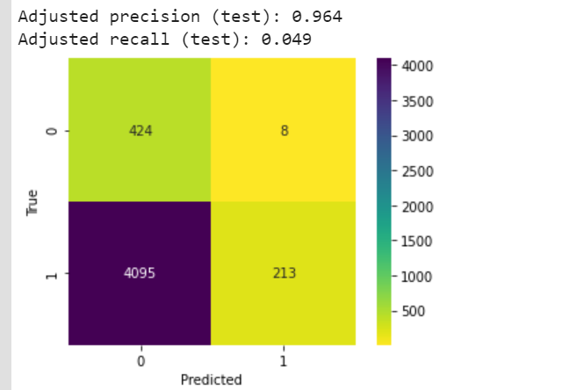
Final results and conclusion
We can see that precision has increased though the recall has reduced significantly. We are predicting a lot of
good loans as bad based on this threshold. So an ideal way forward will be to take more business metrics into hand like using the amount of money and taking into account the interest rate will give us an idea of how much defaults we can handle.

Slide 17
Q&A

